Slide 1
2021 H1 Goal
2021.06.21

Slide 2
Goal
H1 Goal
Objective | Key Result 1 | Key Result 2 | Key Result 3 | Key Result 4
使用Jenkis + Jmeter 執行 API 測試。 | 1.本機架起Jenkis. 2.嘗試執行Jenkis. | 1.收集Deep需要固定執行的API. 2.使用 Jmeter 撰寫API 測試。 | 1.設定 Jenkis在每天早上執行 Jmeter 腳本。 | 1. 透過這個goal 能確保所有API 都是正常運行，如果壞掉可以提早發現並回報問題來減少除錯時間，預計可減少將近30分鐘除錯時間。

Slide 3
Goal - Jenkins & Jmeter
Background
JMeter can use for stress/performance testing, and also service monitoring
Jenkins is a self-contained, open source automation server which can be used to automate all sorts of tasks related to building, testing, and delivering or deploying software
Staging always unstable and not function everyday.
Goal
Find a method and perform api testing and also service monitoring and also support tracking unstable issues with auto team.
Notes:
JMeter 可用於壓力/性能測試，也可用於服務監控
Jenkins 是一個獨立的開源自動化服務器，可用於自動化與構建、測試、交付或部署軟件相關的各種任務
分期總是不穩定，不能每天發揮作用。
目標
找到一種方法並執行 api 測試和服務監控，還支持與自動化團隊一起跟踪不穩定的問題。

Slide 4
Jenkins
Jenkins 是開源軟件項目，基於 Java 開發的持續集成工具，用於監控持續重複的工作，旨在提供一個開放使用的軟件平台，使軟件的持續集成可能。
Jenkins 的主要功能是將項目中重複執行的工作自動化的執行。如軟件的構建（構建）和在配置文件下設置的工作。具體功能大概有：
軟件的持續構建和測試，提供了一個系統，使開發人員很容易將更改集成到工程中。自動化的，的構建有增加開發效率。
監視作業的執行，如下圖所示，作業可以實現很多的功能，Jenkins可以對這些項目進行顯示，讓用戶更清楚的觀察執行的工作項目。
分佈式構建，Jenkins可以將工程構建到多台，更好地利用硬件資源，節省時間。
其他，Jenkins代碼開源，用戶可以自己寫插件。所以jenkins可以實現很多的功能。
Notes:
运行E:\jmeter\script_smoke下面的.jmx脚本，生成.jtl文件放入 E:\jmeter\report_smoke文件中
然后ant再利用指定的.xsl文件(build_smoke_report.xml定义)去解析.jtl文件，生成对应的html文件放入E:\jmeter\report_smoke中。
简写就是：跑完结果后，.xsl文件把.jtl文件转化成直观的html报告。

Slide 5
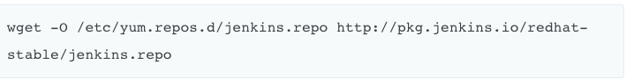
Jenkins installation
Notes:
运行E:\jmeter\script_smoke下面的.jmx脚本，生成.jtl文件放入 E:\jmeter\report_smoke文件中
然后ant再利用指定的.xsl文件(build_smoke_report.xml定义)去解析.jtl文件，生成对应的html文件放入E:\jmeter\report_smoke中。
简写就是：跑完结果后，.xsl文件把.jtl文件转化成直观的html报告。

Slide 6
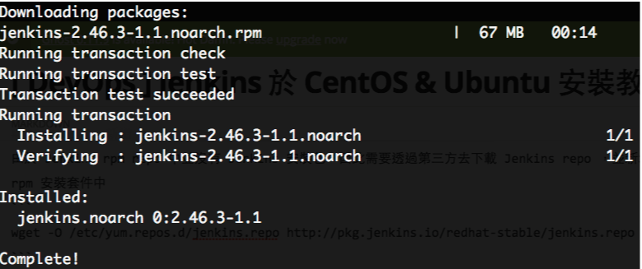
Jenkins installation
Notes:
运行E:\jmeter\script_smoke下面的.jmx脚本，生成.jtl文件放入 E:\jmeter\report_smoke文件中
然后ant再利用指定的.xsl文件(build_smoke_report.xml定义)去解析.jtl文件，生成对应的html文件放入E:\jmeter\report_smoke中。
简写就是：跑完结果后，.xsl文件把.jtl文件转化成直观的html报告。

Slide 7
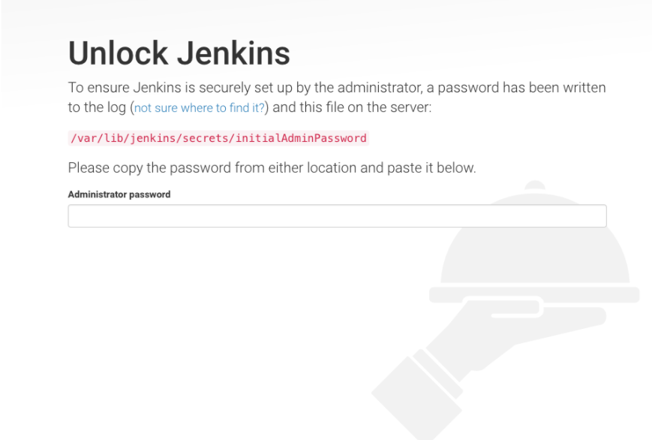
Jenkins installation
Notes:
运行E:\jmeter\script_smoke下面的.jmx脚本，生成.jtl文件放入 E:\jmeter\report_smoke文件中
然后ant再利用指定的.xsl文件(build_smoke_report.xml定义)去解析.jtl文件，生成对应的html文件放入E:\jmeter\report_smoke中。
简写就是：跑完结果后，.xsl文件把.jtl文件转化成直观的html报告。

Slide 8

Jenkins Docker
Notes:
Jenkins 是 CI 老牌工具，透過新的 Docker 技術，快速建立自己的 CI 環境。

Slide 9

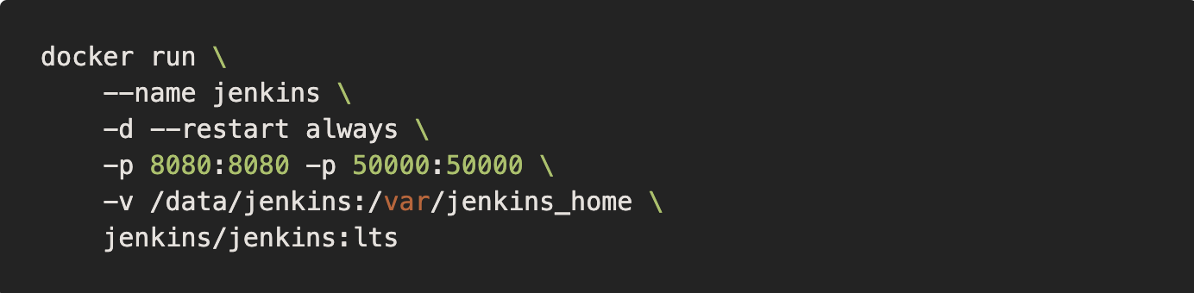
Jenkins Docker

Slide 10

Jenkins Docker
Notes:
运行E:\jmeter\script_smoke下面的.jmx脚本，生成.jtl文件放入 E:\jmeter\report_smoke文件中
然后ant再利用指定的.xsl文件(build_smoke_report.xml定义)去解析.jtl文件，生成对应的html文件放入E:\jmeter\report_smoke中。
简写就是：跑完结果后，.xsl文件把.jtl文件转化成直观的html报告。

Slide 11
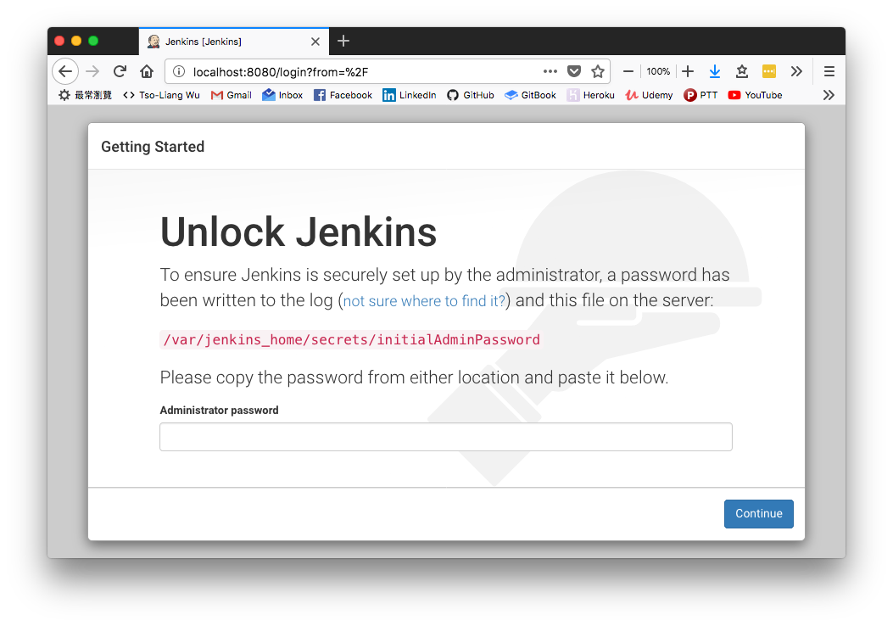
Jenkins Docker
Notes:
运行E:\jmeter\script_smoke下面的.jmx脚本，生成.jtl文件放入 E:\jmeter\report_smoke文件中
然后ant再利用指定的.xsl文件(build_smoke_report.xml定义)去解析.jtl文件，生成对应的html文件放入E:\jmeter\report_smoke中。
简写就是：跑完结果后，.xsl文件把.jtl文件转化成直观的html报告。

Slide 12
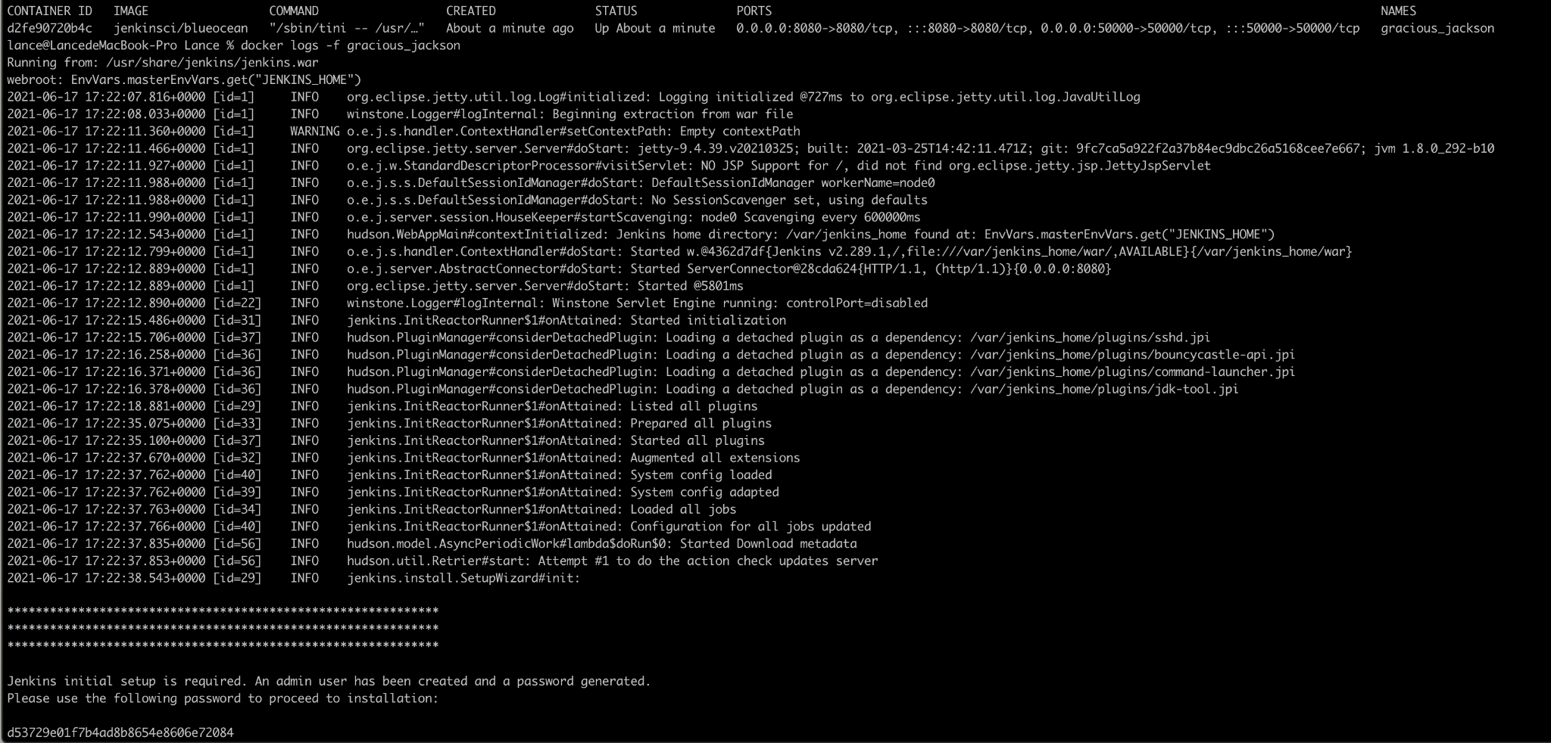
Jenkins Docker
Notes:
运行E:\jmeter\script_smoke下面的.jmx脚本，生成.jtl文件放入 E:\jmeter\report_smoke文件中
然后ant再利用指定的.xsl文件(build_smoke_report.xml定义)去解析.jtl文件，生成对应的html文件放入E:\jmeter\report_smoke中。
简写就是：跑完结果后，.xsl文件把.jtl文件转化成直观的html报告。

Slide 13
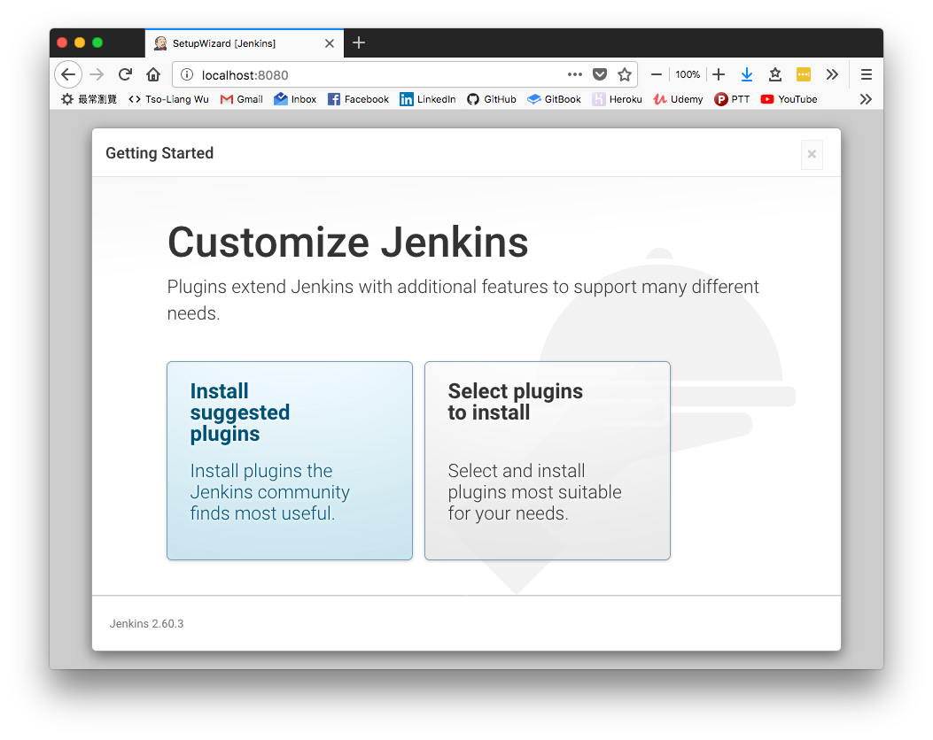
Jenkins
Notes:
运行E:\jmeter\script_smoke下面的.jmx脚本，生成.jtl文件放入 E:\jmeter\report_smoke文件中
然后ant再利用指定的.xsl文件(build_smoke_report.xml定义)去解析.jtl文件，生成对应的html文件放入E:\jmeter\report_smoke中。
简写就是：跑完结果后，.xsl文件把.jtl文件转化成直观的html报告。

Slide 14
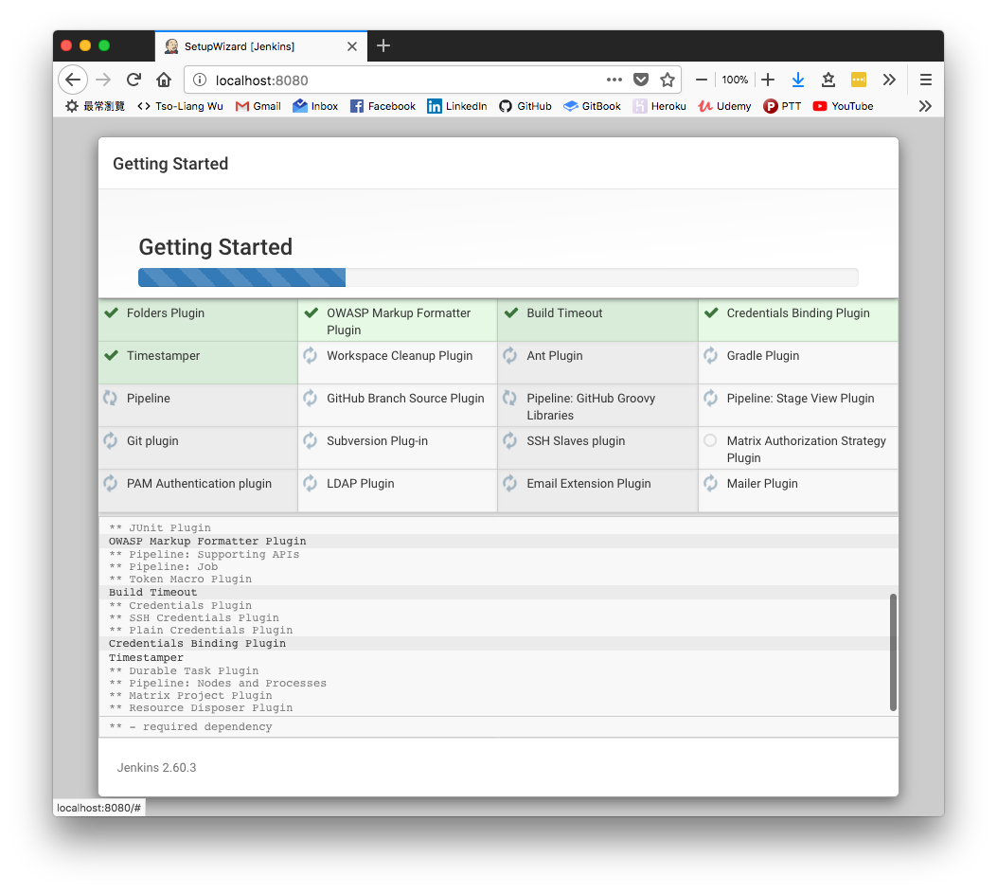
Jenkins
Notes:
运行E:\jmeter\script_smoke下面的.jmx脚本，生成.jtl文件放入 E:\jmeter\report_smoke文件中
然后ant再利用指定的.xsl文件(build_smoke_report.xml定义)去解析.jtl文件，生成对应的html文件放入E:\jmeter\report_smoke中。
简写就是：跑完结果后，.xsl文件把.jtl文件转化成直观的html报告。

Slide 15
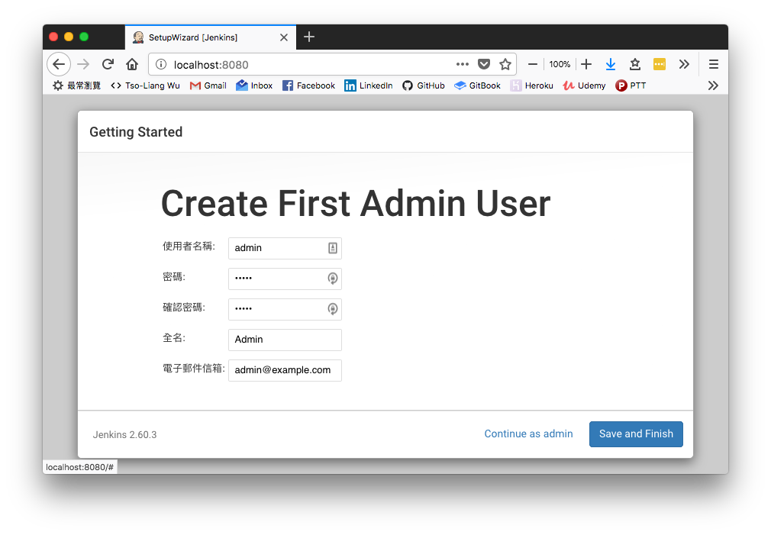
Jenkins
Notes:
运行E:\jmeter\script_smoke下面的.jmx脚本，生成.jtl文件放入 E:\jmeter\report_smoke文件中
然后ant再利用指定的.xsl文件(build_smoke_report.xml定义)去解析.jtl文件，生成对应的html文件放入E:\jmeter\report_smoke中。
简写就是：跑完结果后，.xsl文件把.jtl文件转化成直观的html报告。

Slide 16
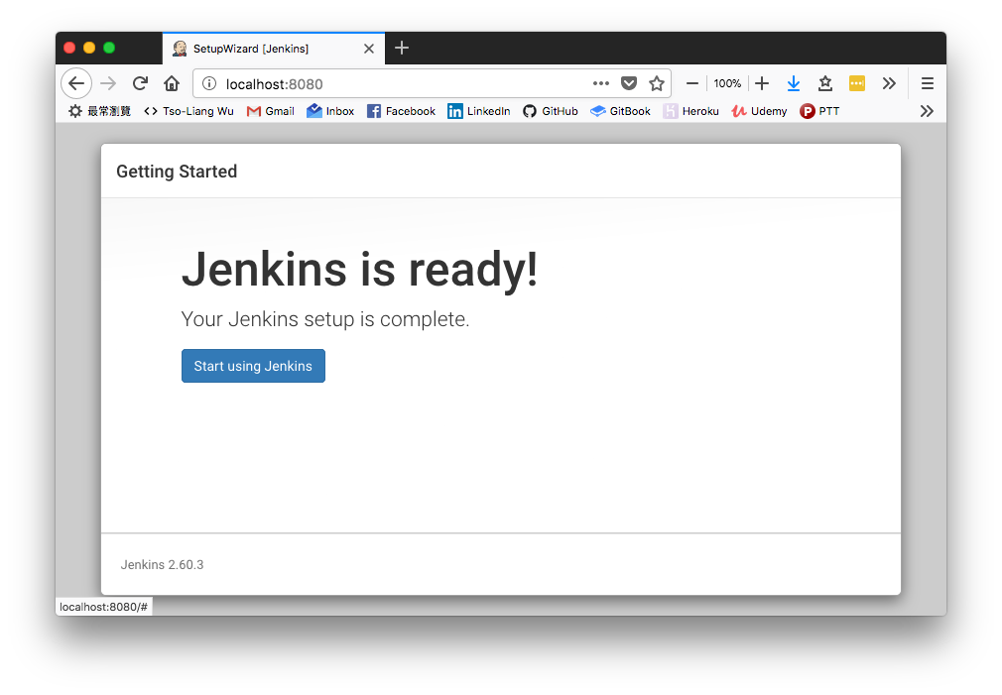
Jenkins
Notes:
运行E:\jmeter\script_smoke下面的.jmx脚本，生成.jtl文件放入 E:\jmeter\report_smoke文件中
然后ant再利用指定的.xsl文件(build_smoke_report.xml定义)去解析.jtl文件，生成对应的html文件放入E:\jmeter\report_smoke中。
简写就是：跑完结果后，.xsl文件把.jtl文件转化成直观的html报告。

Slide 17
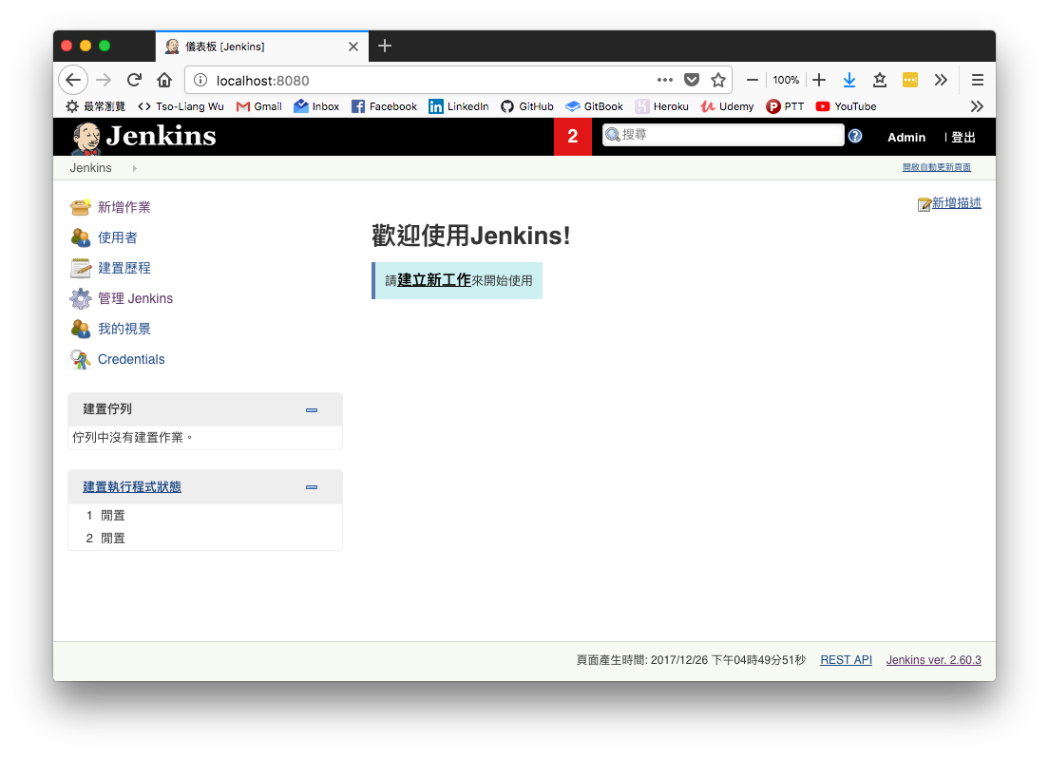
Jenkins
Notes:
运行E:\jmeter\script_smoke下面的.jmx脚本，生成.jtl文件放入 E:\jmeter\report_smoke文件中
然后ant再利用指定的.xsl文件(build_smoke_report.xml定义)去解析.jtl文件，生成对应的html文件放入E:\jmeter\report_smoke中。
简写就是：跑完结果后，.xsl文件把.jtl文件转化成直观的html报告。

Slide 18
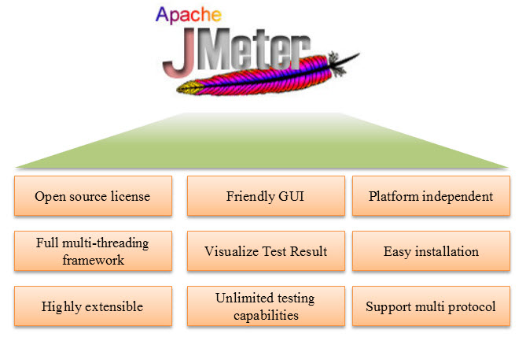
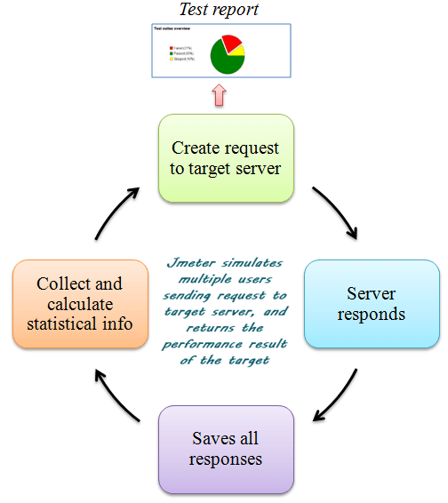
Jmeter
Background
JMeter can use for stress/performance testing, and also service monitoring
Notes:
https://www.guru99.com/introduction-to-jmeter.html
您是否曾經測試過網絡服務器以了解它的工作效率？ Web 服務器可以處理多少並發用戶？ 假設有一天，您的老闆要求您為 100 個用戶對 www.google.com 進行性能測試。你會怎麼辦？
同時=相同的動作，相同的時間。 “每個人都在3、2、1，現在按回車鍵！”在Microfocus LoadRunner中，這由稱為集合點的概念表示。
並發=在相同的時間範圍內操作，但每個操作都獨立於一組操作。
開源許可：JMeter 完全免費，允許開發者使用源代碼進行開發
友好的圖形用戶界面：JMeter 非常易於使用，無需花時間熟悉它
平台無關：JMeter 是 100% 純 Java 桌面應用程序。所以它可以在多個平台上運行
完整的多線程框架。JMeter 允許通過單獨的線程組並發和同時採樣不同的功能
可視化測試結果：測試結果可以以不同的格式顯示，例如圖表、表格、樹和日誌文件
輕鬆安裝：您只需複制並運行 *.bat 文件即可運行 JMeter。無需安裝。
高度可擴展：您可以編寫自己的測試。JMeter 還支持可視化插件，允許您擴展您的測試
多種測試策略：JMeter支持負載測試、分佈式測試、功能測試等多種測試策略。
模擬：JMeter 可以使用並發線程模擬多個用戶，對測試中的 Web 應用程序造成沉重的負載
支持多協議：JMeter 不僅支持 Web 應用程序測試，還評估數據庫服務器性能。JMeter 支持 HTTP、JDBC、LDAP、SOAP、JMS 和 FTP 等所有基本協議
記錄和回放-在瀏覽器上記錄用戶活動並使用 JMeter 在 Web 應用程序中模擬它們
腳本測試：Jmeter 可以與 Bean Shell 和Selenium集成以進行自動化測試。
Open source license: JMeter is totally free, allows developer use the source code for the development
Friendly GUI: JMeter is extremely easy to use and doesn't take time to get familiar with it
Platform independent: JMeter is 100% pure Java desktop application. So it can run on multiple platforms
Full multithreading framework. JMeter allows concurrent and simultaneous sampling of different functions by a separate thread group
Visualize Test Result: Test result can be displayed in a different format such as chart, table, tree and log file
Easy installation: You just copy and run the *.bat file to run JMeter. No installation needed.
Highly Extensible: You can write your own tests. JMeter also supports visualization plugins allow you to extend your testing
Multiple testing strategy: JMeter supports many testing strategies such as Load Testing, Distributed Testing, and Functional Testing.
Simulation: JMeter can simulate multiple users with concurrent threads, create a heavy load against web application under test
Support multi-protocol: JMeter does not only support web application testing but also evaluate database server performance. All basic protocols such as HTTP, JDBC, LDAP, SOAP, JMS, and FTP are supported by JMeter
Record & Playback - Record the user activity on the browser and simulate them in a web application using JMeter
Script Test: Jmeter can be integrated with Bean Shell & Selenium for automated testing.

Slide 19
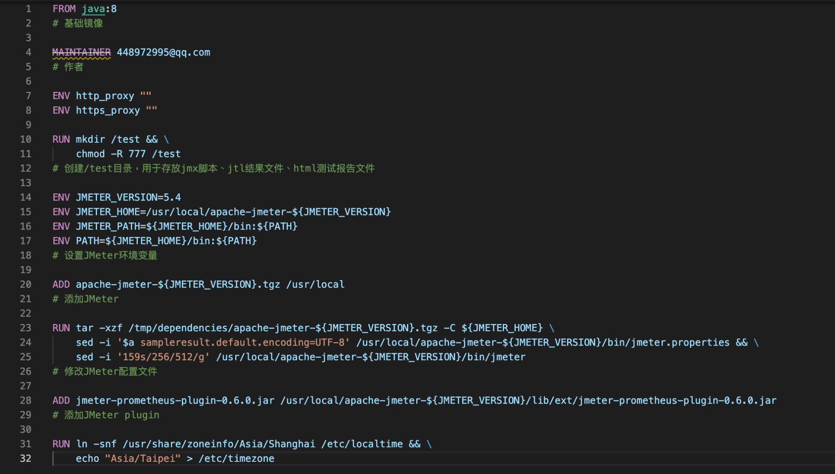
Jmeter installation
Dockerfile.
Easy to maintain a container e.g. Jmeter version upgrade or add/remove plugin
Notes:
https://twgreatdaily.com/7JhhDnEBiuFnsJQVMiww.html

Slide 20
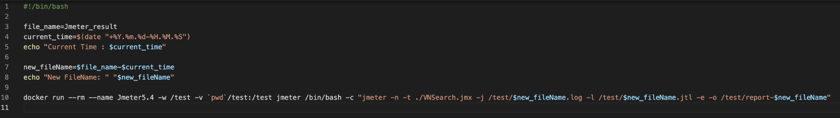
Execute Jmeter
Shell script.
docker build -t jmeter .
mkdir test
add timestamp to Jmeter log file
Launch docker container from Jmeter image
--rm
--name
-v
/bin/bash -c
"jmeter -n -t ./VNSearch.jmx -j /test/$new_fileName.log -l /test/$new_fileName.jtl -e -o /test/report-$new_fileName"
Notes:
https://twgreatdaily.com/7JhhDnEBiuFnsJQVMiww.html

Slide 21
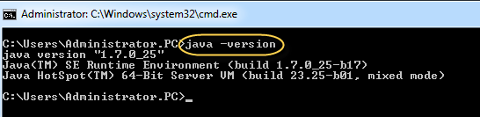
Jmeter installation
Notes:
https://www.guru99.com/guide-to-install-jmeter.html

Slide 22
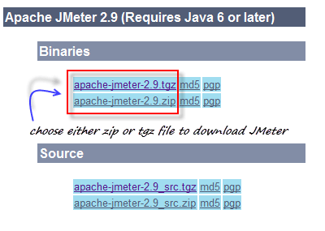
Jmeter installation
Notes:
https://www.guru99.com/guide-to-install-jmeter.html

Slide 23
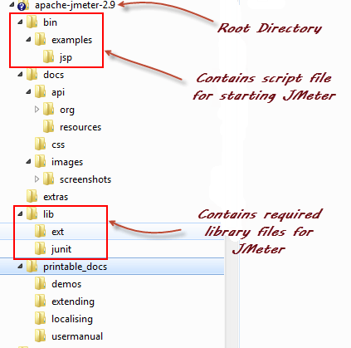
Jmeter installation
Notes:
/ bin : 包含用於啟動 JMeter 的 JMeter 腳本文件
/ docs：JMeter 文檔文件
/extras : ant 相關的額外文件
/ lib /：包含JMeter所需的Java庫
/lib/ext：包含 JMeter 和協議的核心 jar 文件
/lib/junit：用於 JMeter 的Junit庫

Slide 24
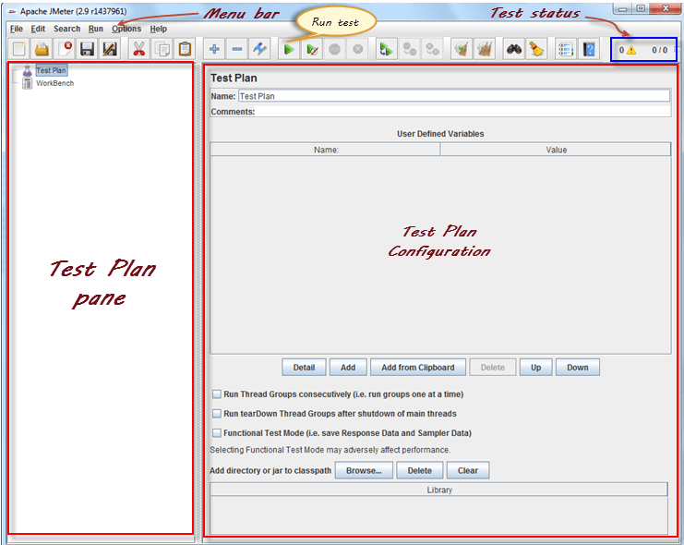
Jmeter installation
Notes:
如果您使用的是 Window，只需運行文件/bin/jmeter.bat即可在 GUI 模式下啟動 JMeter，如下所示

Slide 25
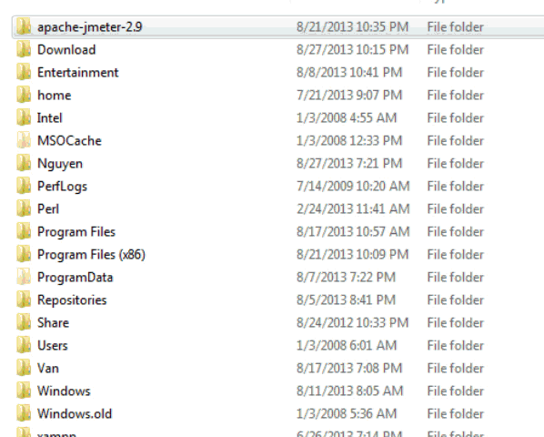
Jmeter installation
Notes:
如果您使用的是 Window，只需運行文件/bin/jmeter.bat即可在 GUI 模式下啟動 JMeter，如下所示

Slide 26
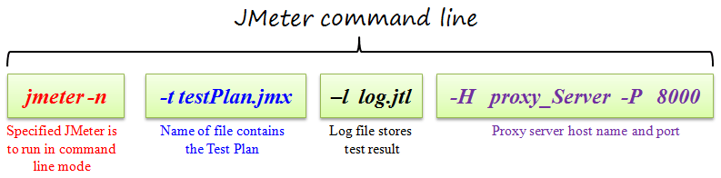
Jmeter installation
Why Docker
Easy to run anywhere and pure env
Save the time to do installation for every user
Notes:
https://www.guru99.com/guide-to-install-jmeter.html

Slide 27
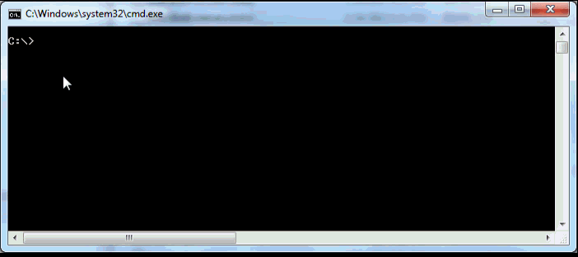
Jmeter installation
Notes:
https://www.guru99.com/guide-to-install-jmeter.html

Slide 28
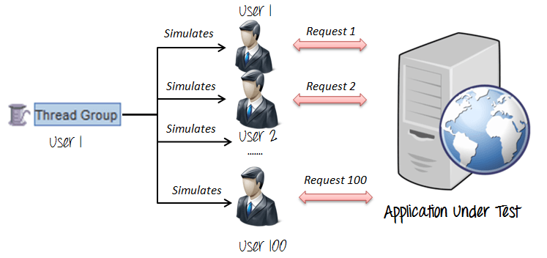
Jmeter
Notes:
https://www.guru99.com/guide-to-install-jmeter.html

Slide 29

Jmeter Docker
Notes:
Jenkins 是 CI 老牌工具，透過新的 Docker 技術，快速建立自己的 CI 環境。

Slide 30
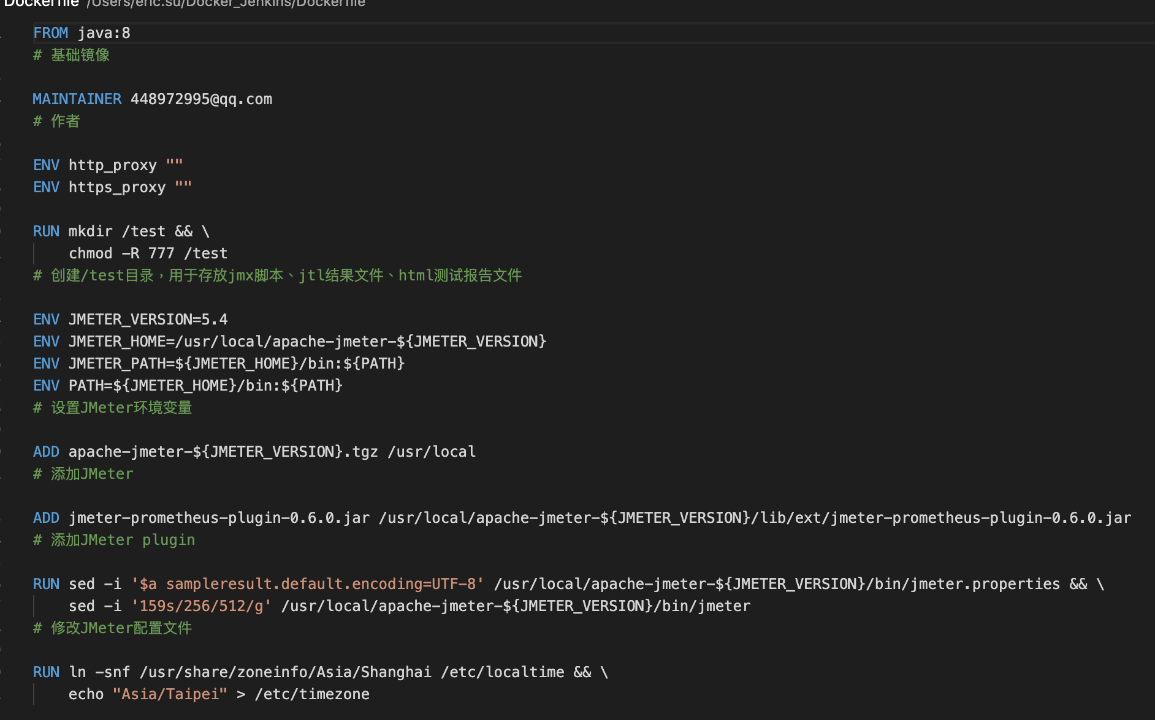
Jmeter Docker File
Notes:
运行E:\jmeter\script_smoke下面的.jmx脚本，生成.jtl文件放入 E:\jmeter\report_smoke文件中
然后ant再利用指定的.xsl文件(build_smoke_report.xml定义)去解析.jtl文件，生成对应的html文件放入E:\jmeter\report_smoke中。
简写就是：跑完结果后，.xsl文件把.jtl文件转化成直观的html报告。

Slide 31
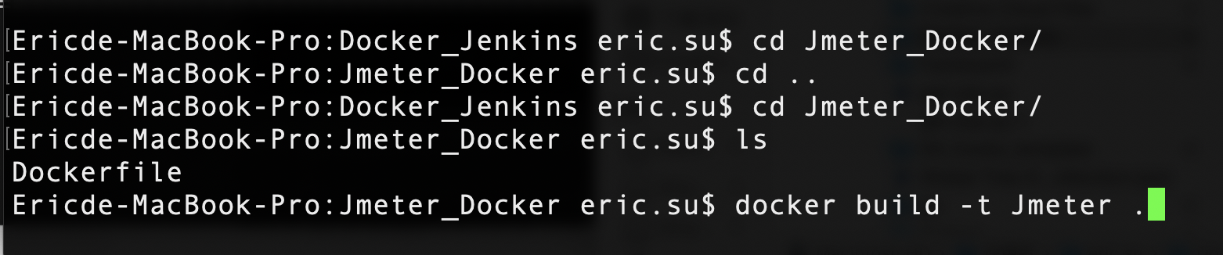
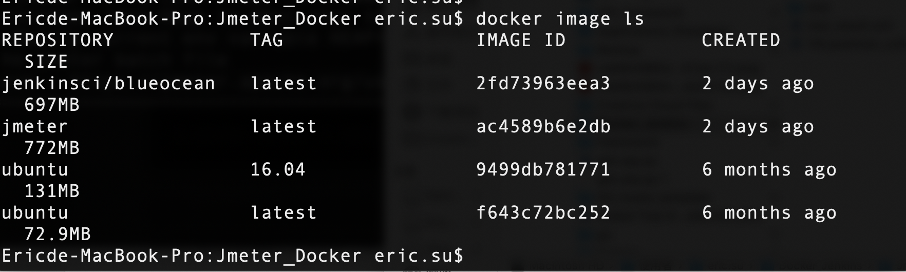
Jmeter Docker
Notes:
运行E:\jmeter\script_smoke下面的.jmx脚本，生成.jtl文件放入 E:\jmeter\report_smoke文件中
然后ant再利用指定的.xsl文件(build_smoke_report.xml定义)去解析.jtl文件，生成对应的html文件放入E:\jmeter\report_smoke中。
简写就是：跑完结果后，.xsl文件把.jtl文件转化成直观的html报告。

Slide 32
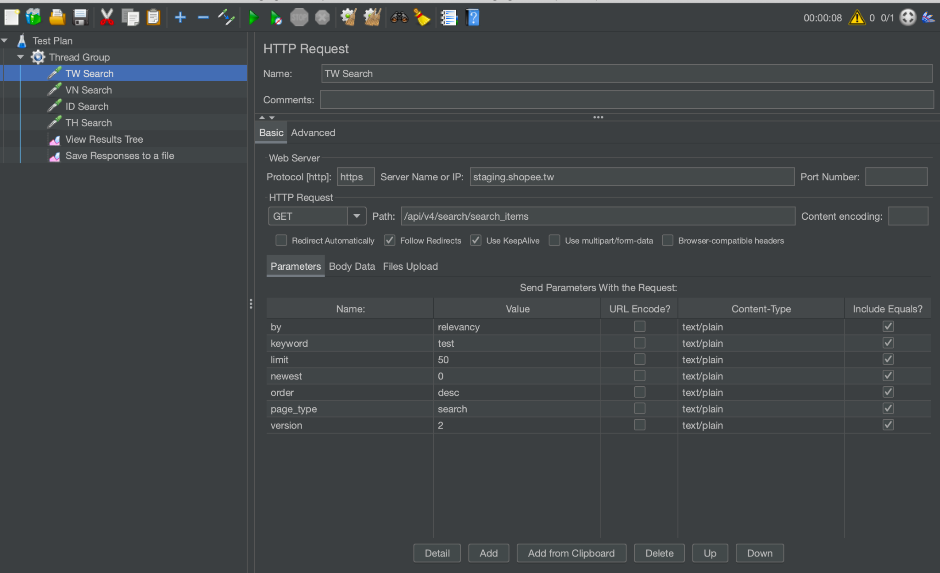
Jmeter Script
Notes:
运行E:\jmeter\script_smoke下面的.jmx脚本，生成.jtl文件放入 E:\jmeter\report_smoke文件中
然后ant再利用指定的.xsl文件(build_smoke_report.xml定义)去解析.jtl文件，生成对应的html文件放入E:\jmeter\report_smoke中。
简写就是：跑完结果后，.xsl文件把.jtl文件转化成直观的html报告。

Slide 33
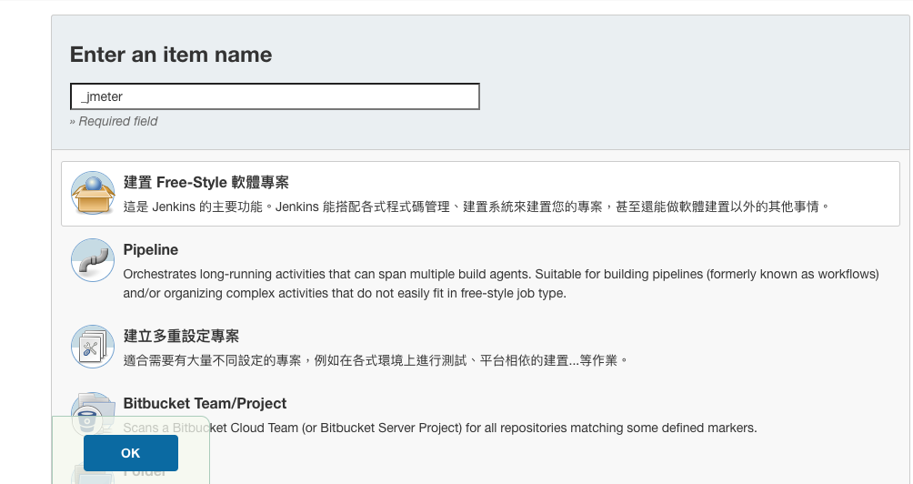
Jenkins
Notes:
REF https://blog.csdn.net/zbj18314469395/article/details/104566755 https://www.cnblogs.com/zibinchen/p/14208930.html https://www.jianshu.com/p/69f1aa64a92b https://zhuanlan.zhihu.com/p/37735496 https://ithelp.ithome.com.tw/articles/10196252 https://www.guru99.com/jmeter-element-reference.html https://ithelp.ithome.com.tw/articles/10250988 https://philipzheng.gitbook.io/docker_practice/dockerfile/instructions https://arophix.com/2018/04/15/setup-jenkins-with-docker/ https://iter01.com/548865.html https://github.com/justb4/docker-jmeter https://twgreatdaily.com/7JhhDnEBiuFnsJQVMiww.html https://github.com/anoppe/influxdb-grafana-jmeter-docker https://github.com/metersphere/jmeter-image https://www.twblogs.net/a/5d3f618dbd9eee51fbf91767 https://ithelp.ithome.com.tw/articles/10192397 https://www.796t.com/article.php?id=50559 https://dev.to/qainsights/jmeter-prometheus-and-grafana-integration-312n https://www.itread01.com/qeiyi.html https://github.com/jenkinsci/docker https://blog.fit2cloud.com/?p=1621 https://medium.com/@ellenhuang523/a-docker-solution-to-jmeter-influxdb-grafana-performance-testing-568848de7a0f

Slide 34
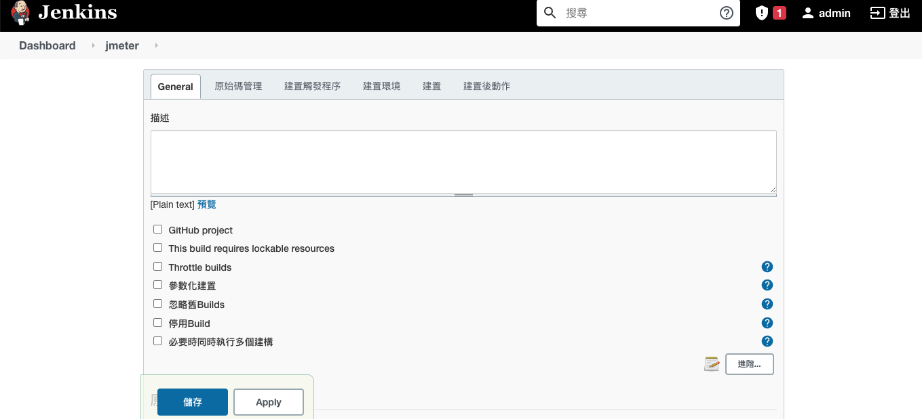
Jenkins
Notes:
REF https://blog.csdn.net/zbj18314469395/article/details/104566755 https://www.cnblogs.com/zibinchen/p/14208930.html https://www.jianshu.com/p/69f1aa64a92b https://zhuanlan.zhihu.com/p/37735496 https://ithelp.ithome.com.tw/articles/10196252 https://www.guru99.com/jmeter-element-reference.html https://ithelp.ithome.com.tw/articles/10250988 https://philipzheng.gitbook.io/docker_practice/dockerfile/instructions https://arophix.com/2018/04/15/setup-jenkins-with-docker/ https://iter01.com/548865.html https://github.com/justb4/docker-jmeter https://twgreatdaily.com/7JhhDnEBiuFnsJQVMiww.html https://github.com/anoppe/influxdb-grafana-jmeter-docker https://github.com/metersphere/jmeter-image https://www.twblogs.net/a/5d3f618dbd9eee51fbf91767 https://ithelp.ithome.com.tw/articles/10192397 https://www.796t.com/article.php?id=50559 https://dev.to/qainsights/jmeter-prometheus-and-grafana-integration-312n https://www.itread01.com/qeiyi.html https://github.com/jenkinsci/docker https://blog.fit2cloud.com/?p=1621 https://medium.com/@ellenhuang523/a-docker-solution-to-jmeter-influxdb-grafana-performance-testing-568848de7a0f

Slide 35
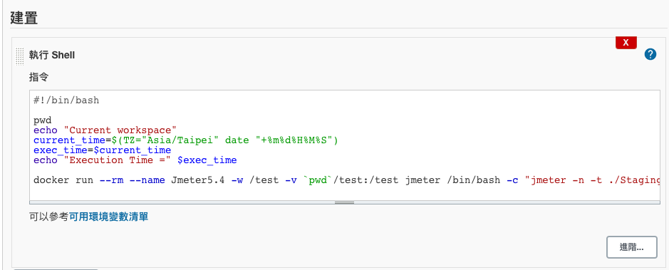
Jenkins
Notes:
REF https://blog.csdn.net/zbj18314469395/article/details/104566755 https://www.cnblogs.com/zibinchen/p/14208930.html https://www.jianshu.com/p/69f1aa64a92b https://zhuanlan.zhihu.com/p/37735496 https://ithelp.ithome.com.tw/articles/10196252 https://www.guru99.com/jmeter-element-reference.html https://ithelp.ithome.com.tw/articles/10250988 https://philipzheng.gitbook.io/docker_practice/dockerfile/instructions https://arophix.com/2018/04/15/setup-jenkins-with-docker/ https://iter01.com/548865.html https://github.com/justb4/docker-jmeter https://twgreatdaily.com/7JhhDnEBiuFnsJQVMiww.html https://github.com/anoppe/influxdb-grafana-jmeter-docker https://github.com/metersphere/jmeter-image https://www.twblogs.net/a/5d3f618dbd9eee51fbf91767 https://ithelp.ithome.com.tw/articles/10192397 https://www.796t.com/article.php?id=50559 https://dev.to/qainsights/jmeter-prometheus-and-grafana-integration-312n https://www.itread01.com/qeiyi.html https://github.com/jenkinsci/docker https://blog.fit2cloud.com/?p=1621 https://medium.com/@ellenhuang523/a-docker-solution-to-jmeter-influxdb-grafana-performance-testing-568848de7a0f

Slide 36
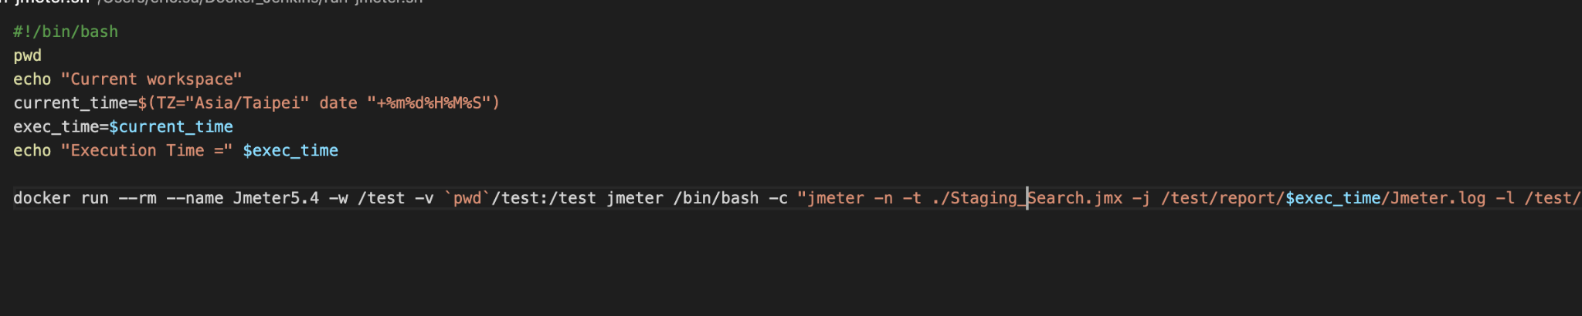
Jenkins
Notes:
REF https://blog.csdn.net/zbj18314469395/article/details/104566755 https://www.cnblogs.com/zibinchen/p/14208930.html https://www.jianshu.com/p/69f1aa64a92b https://zhuanlan.zhihu.com/p/37735496 https://ithelp.ithome.com.tw/articles/10196252 https://www.guru99.com/jmeter-element-reference.html https://ithelp.ithome.com.tw/articles/10250988 https://philipzheng.gitbook.io/docker_practice/dockerfile/instructions https://arophix.com/2018/04/15/setup-jenkins-with-docker/ https://iter01.com/548865.html https://github.com/justb4/docker-jmeter https://twgreatdaily.com/7JhhDnEBiuFnsJQVMiww.html https://github.com/anoppe/influxdb-grafana-jmeter-docker https://github.com/metersphere/jmeter-image https://www.twblogs.net/a/5d3f618dbd9eee51fbf91767 https://ithelp.ithome.com.tw/articles/10192397 https://www.796t.com/article.php?id=50559 https://dev.to/qainsights/jmeter-prometheus-and-grafana-integration-312n https://www.itread01.com/qeiyi.html https://github.com/jenkinsci/docker https://blog.fit2cloud.com/?p=1621 https://medium.com/@ellenhuang523/a-docker-solution-to-jmeter-influxdb-grafana-performance-testing-568848de7a0f

Slide 37
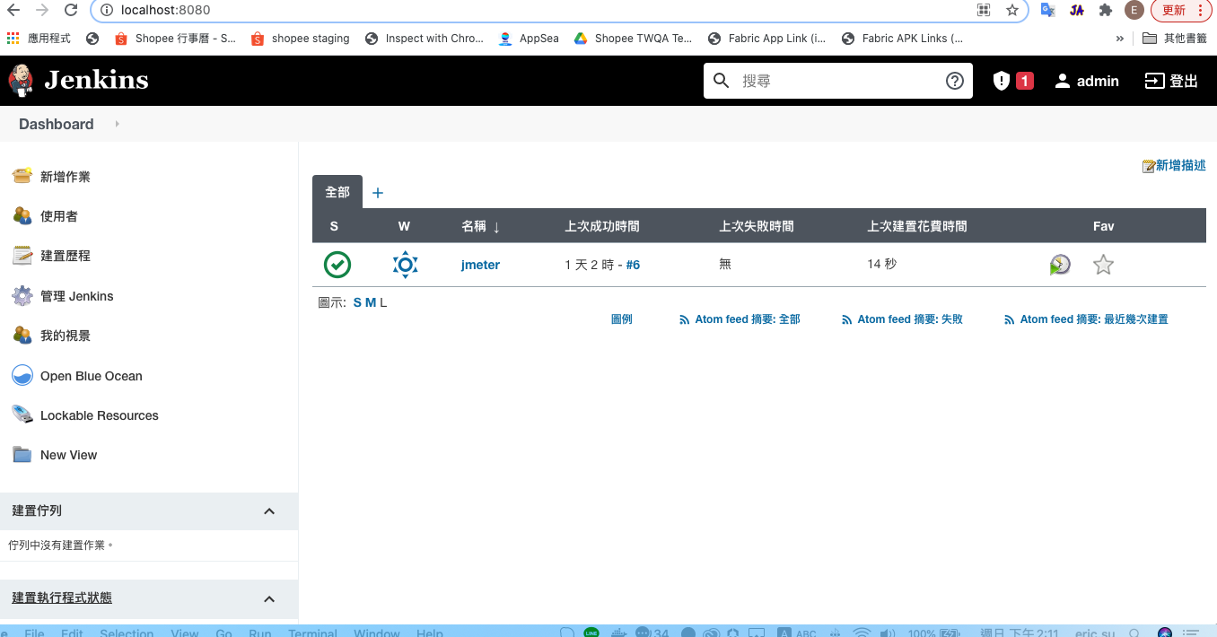
Jenkins
Notes:
REF https://blog.csdn.net/zbj18314469395/article/details/104566755 https://www.cnblogs.com/zibinchen/p/14208930.html https://www.jianshu.com/p/69f1aa64a92b https://zhuanlan.zhihu.com/p/37735496 https://ithelp.ithome.com.tw/articles/10196252 https://www.guru99.com/jmeter-element-reference.html https://ithelp.ithome.com.tw/articles/10250988 https://philipzheng.gitbook.io/docker_practice/dockerfile/instructions https://arophix.com/2018/04/15/setup-jenkins-with-docker/ https://iter01.com/548865.html https://github.com/justb4/docker-jmeter https://twgreatdaily.com/7JhhDnEBiuFnsJQVMiww.html https://github.com/anoppe/influxdb-grafana-jmeter-docker https://github.com/metersphere/jmeter-image https://www.twblogs.net/a/5d3f618dbd9eee51fbf91767 https://ithelp.ithome.com.tw/articles/10192397 https://www.796t.com/article.php?id=50559 https://dev.to/qainsights/jmeter-prometheus-and-grafana-integration-312n https://www.itread01.com/qeiyi.html https://github.com/jenkinsci/docker https://blog.fit2cloud.com/?p=1621 https://medium.com/@ellenhuang523/a-docker-solution-to-jmeter-influxdb-grafana-performance-testing-568848de7a0f

Slide 38
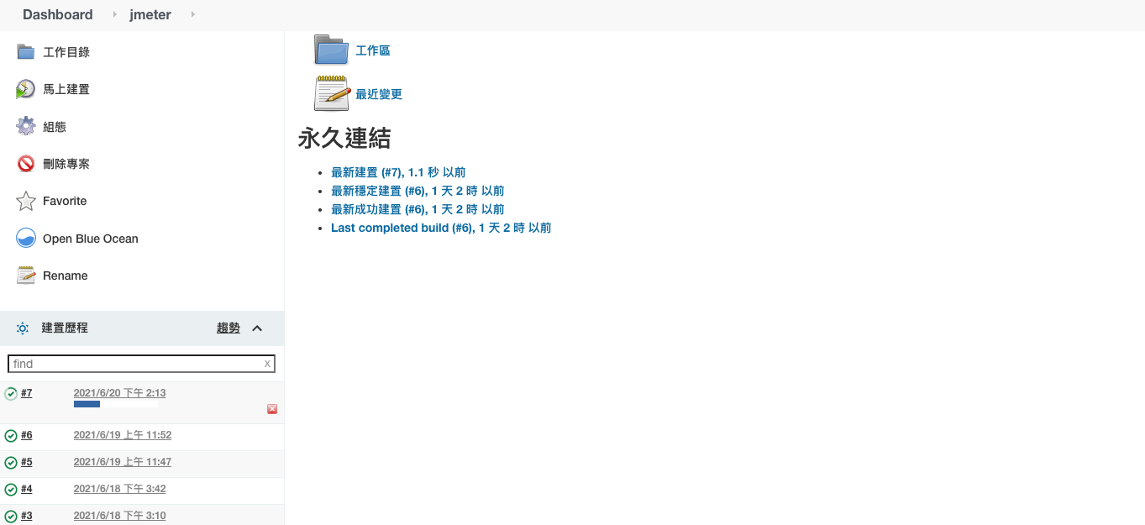
Jenkins Jmeter
Notes:
REF https://blog.csdn.net/zbj18314469395/article/details/104566755 https://www.cnblogs.com/zibinchen/p/14208930.html https://www.jianshu.com/p/69f1aa64a92b https://zhuanlan.zhihu.com/p/37735496 https://ithelp.ithome.com.tw/articles/10196252 https://www.guru99.com/jmeter-element-reference.html https://ithelp.ithome.com.tw/articles/10250988 https://philipzheng.gitbook.io/docker_practice/dockerfile/instructions https://arophix.com/2018/04/15/setup-jenkins-with-docker/ https://iter01.com/548865.html https://github.com/justb4/docker-jmeter https://twgreatdaily.com/7JhhDnEBiuFnsJQVMiww.html https://github.com/anoppe/influxdb-grafana-jmeter-docker https://github.com/metersphere/jmeter-image https://www.twblogs.net/a/5d3f618dbd9eee51fbf91767 https://ithelp.ithome.com.tw/articles/10192397 https://www.796t.com/article.php?id=50559 https://dev.to/qainsights/jmeter-prometheus-and-grafana-integration-312n https://www.itread01.com/qeiyi.html https://github.com/jenkinsci/docker https://blog.fit2cloud.com/?p=1621 https://medium.com/@ellenhuang523/a-docker-solution-to-jmeter-influxdb-grafana-performance-testing-568848de7a0f

Slide 39
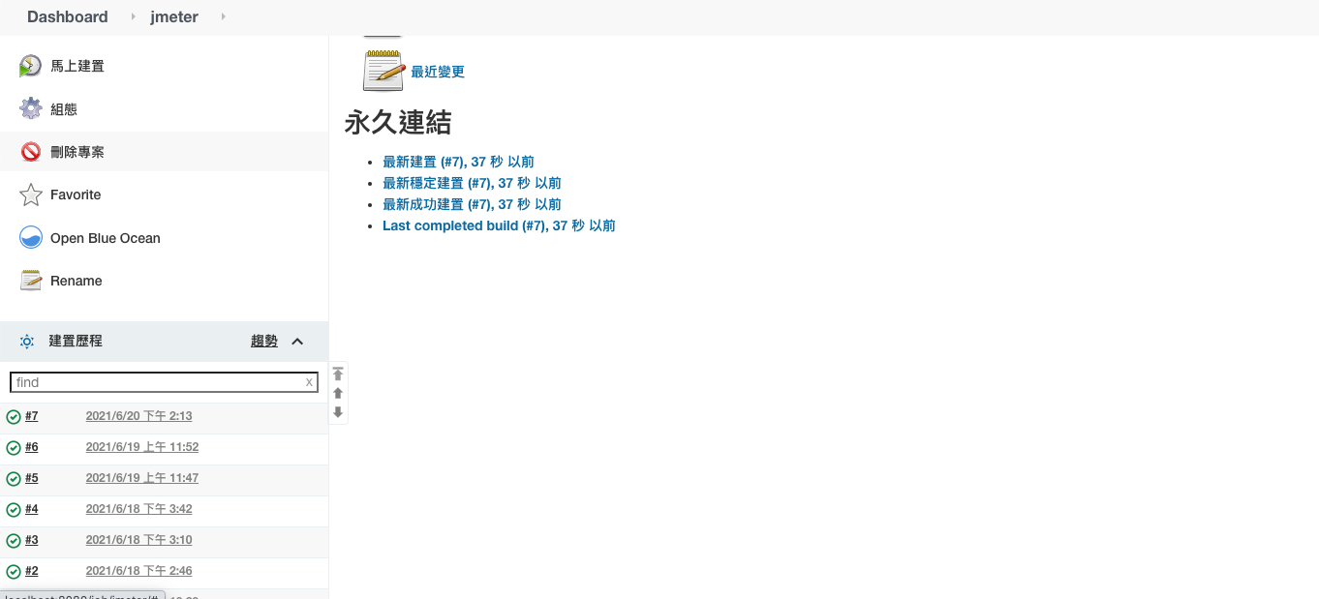
Jenkins Jmeter
Notes:
REF https://blog.csdn.net/zbj18314469395/article/details/104566755 https://www.cnblogs.com/zibinchen/p/14208930.html https://www.jianshu.com/p/69f1aa64a92b https://zhuanlan.zhihu.com/p/37735496 https://ithelp.ithome.com.tw/articles/10196252 https://www.guru99.com/jmeter-element-reference.html https://ithelp.ithome.com.tw/articles/10250988 https://philipzheng.gitbook.io/docker_practice/dockerfile/instructions https://arophix.com/2018/04/15/setup-jenkins-with-docker/ https://iter01.com/548865.html https://github.com/justb4/docker-jmeter https://twgreatdaily.com/7JhhDnEBiuFnsJQVMiww.html https://github.com/anoppe/influxdb-grafana-jmeter-docker https://github.com/metersphere/jmeter-image https://www.twblogs.net/a/5d3f618dbd9eee51fbf91767 https://ithelp.ithome.com.tw/articles/10192397 https://www.796t.com/article.php?id=50559 https://dev.to/qainsights/jmeter-prometheus-and-grafana-integration-312n https://www.itread01.com/qeiyi.html https://github.com/jenkinsci/docker https://blog.fit2cloud.com/?p=1621 https://medium.com/@ellenhuang523/a-docker-solution-to-jmeter-influxdb-grafana-performance-testing-568848de7a0f

Slide 40
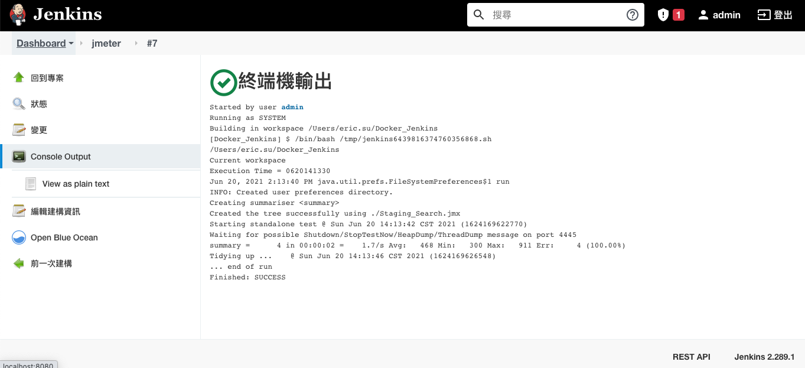
Jenkins Jmeter
Notes:
REF https://blog.csdn.net/zbj18314469395/article/details/104566755 https://www.cnblogs.com/zibinchen/p/14208930.html https://www.jianshu.com/p/69f1aa64a92b https://zhuanlan.zhihu.com/p/37735496 https://ithelp.ithome.com.tw/articles/10196252 https://www.guru99.com/jmeter-element-reference.html https://ithelp.ithome.com.tw/articles/10250988 https://philipzheng.gitbook.io/docker_practice/dockerfile/instructions https://arophix.com/2018/04/15/setup-jenkins-with-docker/ https://iter01.com/548865.html https://github.com/justb4/docker-jmeter https://twgreatdaily.com/7JhhDnEBiuFnsJQVMiww.html https://github.com/anoppe/influxdb-grafana-jmeter-docker https://github.com/metersphere/jmeter-image https://www.twblogs.net/a/5d3f618dbd9eee51fbf91767 https://ithelp.ithome.com.tw/articles/10192397 https://www.796t.com/article.php?id=50559 https://dev.to/qainsights/jmeter-prometheus-and-grafana-integration-312n https://www.itread01.com/qeiyi.html https://github.com/jenkinsci/docker https://blog.fit2cloud.com/?p=1621 https://medium.com/@ellenhuang523/a-docker-solution-to-jmeter-influxdb-grafana-performance-testing-568848de7a0f

Slide 41
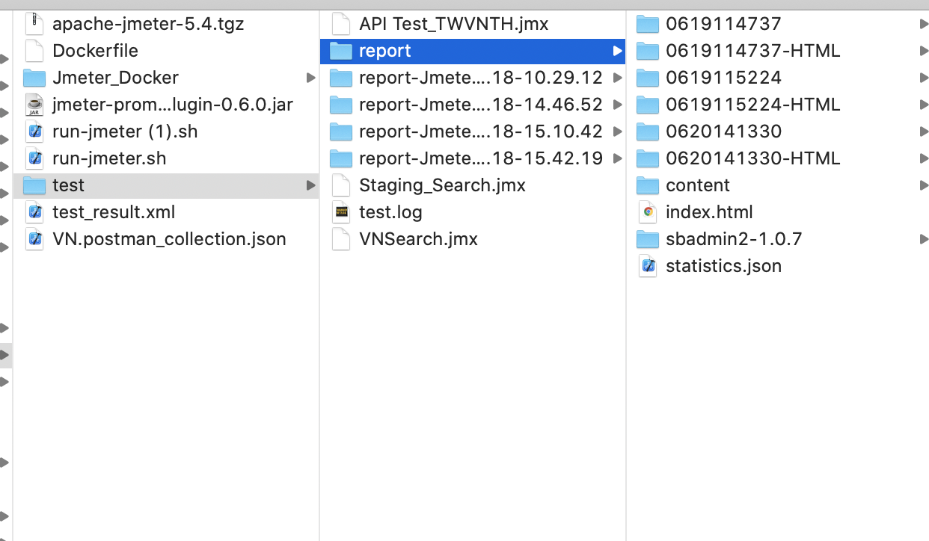
Jenkins Jmeter
Notes:
REF https://blog.csdn.net/zbj18314469395/article/details/104566755 https://www.cnblogs.com/zibinchen/p/14208930.html https://www.jianshu.com/p/69f1aa64a92b https://zhuanlan.zhihu.com/p/37735496 https://ithelp.ithome.com.tw/articles/10196252 https://www.guru99.com/jmeter-element-reference.html https://ithelp.ithome.com.tw/articles/10250988 https://philipzheng.gitbook.io/docker_practice/dockerfile/instructions https://arophix.com/2018/04/15/setup-jenkins-with-docker/ https://iter01.com/548865.html https://github.com/justb4/docker-jmeter https://twgreatdaily.com/7JhhDnEBiuFnsJQVMiww.html https://github.com/anoppe/influxdb-grafana-jmeter-docker https://github.com/metersphere/jmeter-image https://www.twblogs.net/a/5d3f618dbd9eee51fbf91767 https://ithelp.ithome.com.tw/articles/10192397 https://www.796t.com/article.php?id=50559 https://dev.to/qainsights/jmeter-prometheus-and-grafana-integration-312n https://www.itread01.com/qeiyi.html https://github.com/jenkinsci/docker https://blog.fit2cloud.com/?p=1621 https://medium.com/@ellenhuang523/a-docker-solution-to-jmeter-influxdb-grafana-performance-testing-568848de7a0f

Slide 42
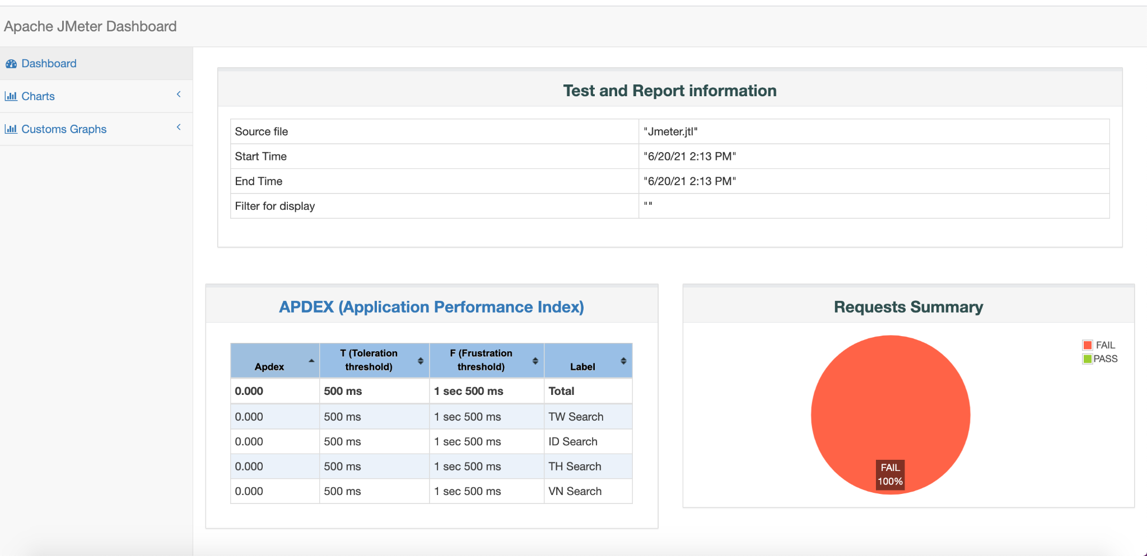
Jenkins Jmeter
Notes:
REF https://blog.csdn.net/zbj18314469395/article/details/104566755 https://www.cnblogs.com/zibinchen/p/14208930.html https://www.jianshu.com/p/69f1aa64a92b https://zhuanlan.zhihu.com/p/37735496 https://ithelp.ithome.com.tw/articles/10196252 https://www.guru99.com/jmeter-element-reference.html https://ithelp.ithome.com.tw/articles/10250988 https://philipzheng.gitbook.io/docker_practice/dockerfile/instructions https://arophix.com/2018/04/15/setup-jenkins-with-docker/ https://iter01.com/548865.html https://github.com/justb4/docker-jmeter https://twgreatdaily.com/7JhhDnEBiuFnsJQVMiww.html https://github.com/anoppe/influxdb-grafana-jmeter-docker https://github.com/metersphere/jmeter-image https://www.twblogs.net/a/5d3f618dbd9eee51fbf91767 https://ithelp.ithome.com.tw/articles/10192397 https://www.796t.com/article.php?id=50559 https://dev.to/qainsights/jmeter-prometheus-and-grafana-integration-312n https://www.itread01.com/qeiyi.html https://github.com/jenkinsci/docker https://blog.fit2cloud.com/?p=1621 https://medium.com/@ellenhuang523/a-docker-solution-to-jmeter-influxdb-grafana-performance-testing-568848de7a0f

Slide 43
Jenkins
DEMO
Notes:
REF https://blog.csdn.net/zbj18314469395/article/details/104566755 https://www.cnblogs.com/zibinchen/p/14208930.html https://www.jianshu.com/p/69f1aa64a92b https://zhuanlan.zhihu.com/p/37735496 https://ithelp.ithome.com.tw/articles/10196252 https://www.guru99.com/jmeter-element-reference.html https://ithelp.ithome.com.tw/articles/10250988 https://philipzheng.gitbook.io/docker_practice/dockerfile/instructions https://arophix.com/2018/04/15/setup-jenkins-with-docker/ https://iter01.com/548865.html https://github.com/justb4/docker-jmeter https://twgreatdaily.com/7JhhDnEBiuFnsJQVMiww.html https://github.com/anoppe/influxdb-grafana-jmeter-docker https://github.com/metersphere/jmeter-image https://www.twblogs.net/a/5d3f618dbd9eee51fbf91767 https://ithelp.ithome.com.tw/articles/10192397 https://www.796t.com/article.php?id=50559 https://dev.to/qainsights/jmeter-prometheus-and-grafana-integration-312n https://www.itread01.com/qeiyi.html https://github.com/jenkinsci/docker https://blog.fit2cloud.com/?p=1621 https://medium.com/@ellenhuang523/a-docker-solution-to-jmeter-influxdb-grafana-performance-testing-568848de7a0f

Slide 44
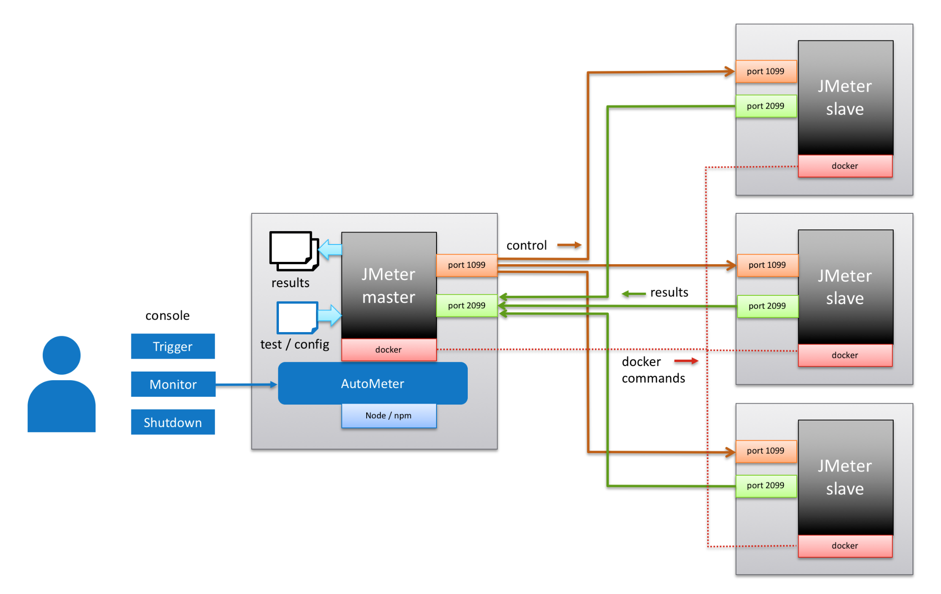
Jenkins
Notes:
https://github.com/intuit/autometer
REF https://blog.csdn.net/zbj18314469395/article/details/104566755 https://www.cnblogs.com/zibinchen/p/14208930.html https://www.jianshu.com/p/69f1aa64a92b https://zhuanlan.zhihu.com/p/37735496 https://ithelp.ithome.com.tw/articles/10196252 https://www.guru99.com/jmeter-element-reference.html https://ithelp.ithome.com.tw/articles/10250988 https://philipzheng.gitbook.io/docker_practice/dockerfile/instructions https://arophix.com/2018/04/15/setup-jenkins-with-docker/ https://iter01.com/548865.html https://github.com/justb4/docker-jmeter https://twgreatdaily.com/7JhhDnEBiuFnsJQVMiww.html https://github.com/anoppe/influxdb-grafana-jmeter-docker https://github.com/metersphere/jmeter-image https://www.twblogs.net/a/5d3f618dbd9eee51fbf91767 https://ithelp.ithome.com.tw/articles/10192397 https://www.796t.com/article.php?id=50559 https://dev.to/qainsights/jmeter-prometheus-and-grafana-integration-312n https://www.itread01.com/qeiyi.html https://github.com/jenkinsci/docker https://blog.fit2cloud.com/?p=1621 https://medium.com/@ellenhuang523/a-docker-solution-to-jmeter-influxdb-grafana-performance-testing-568848de7a0f

